Slide 1
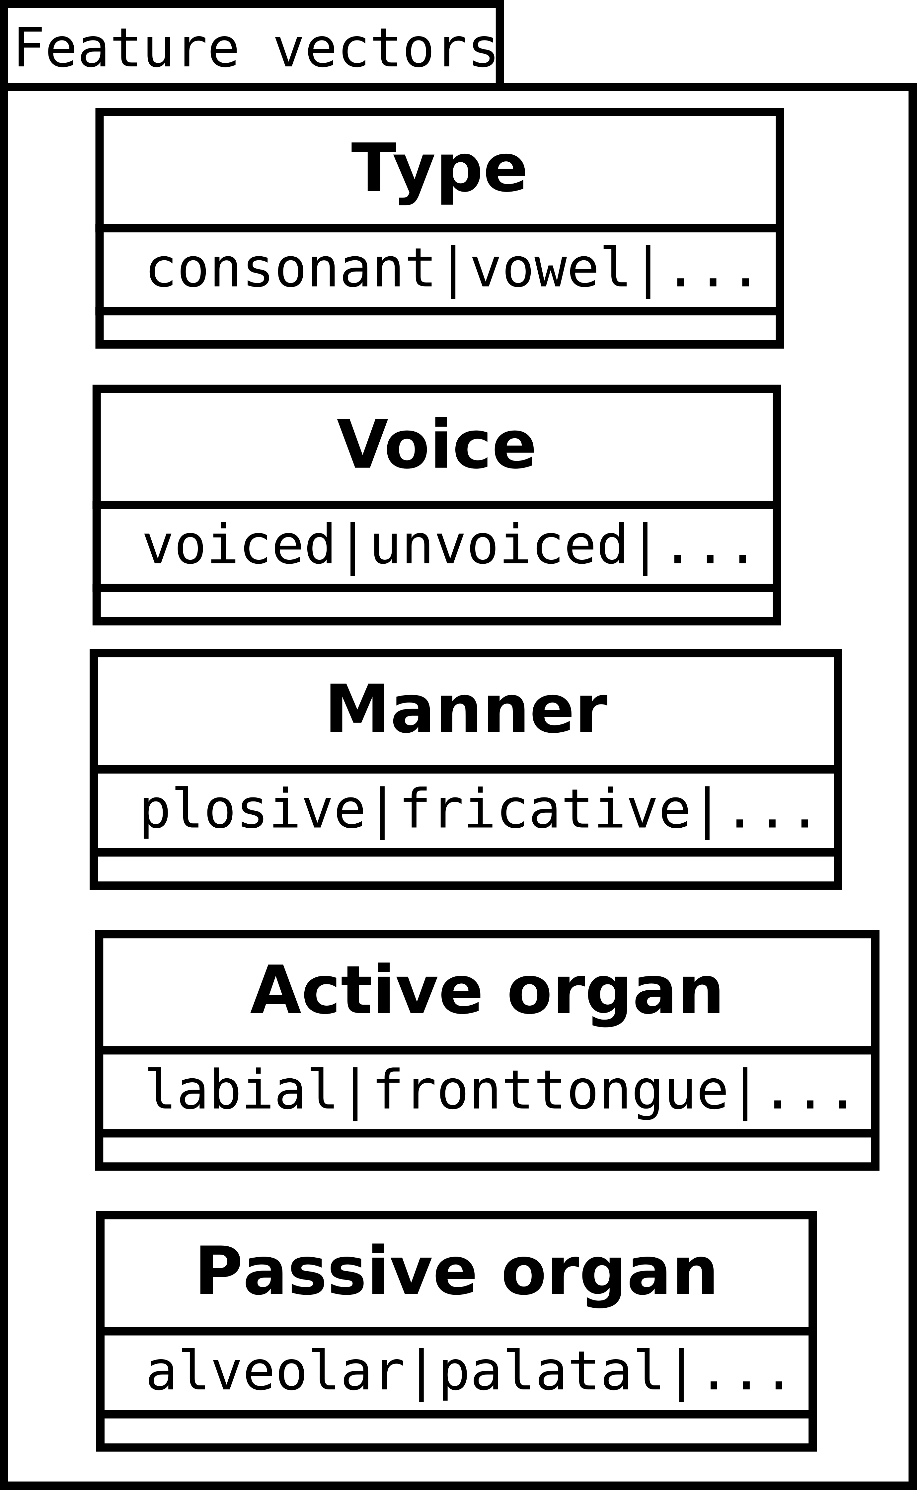
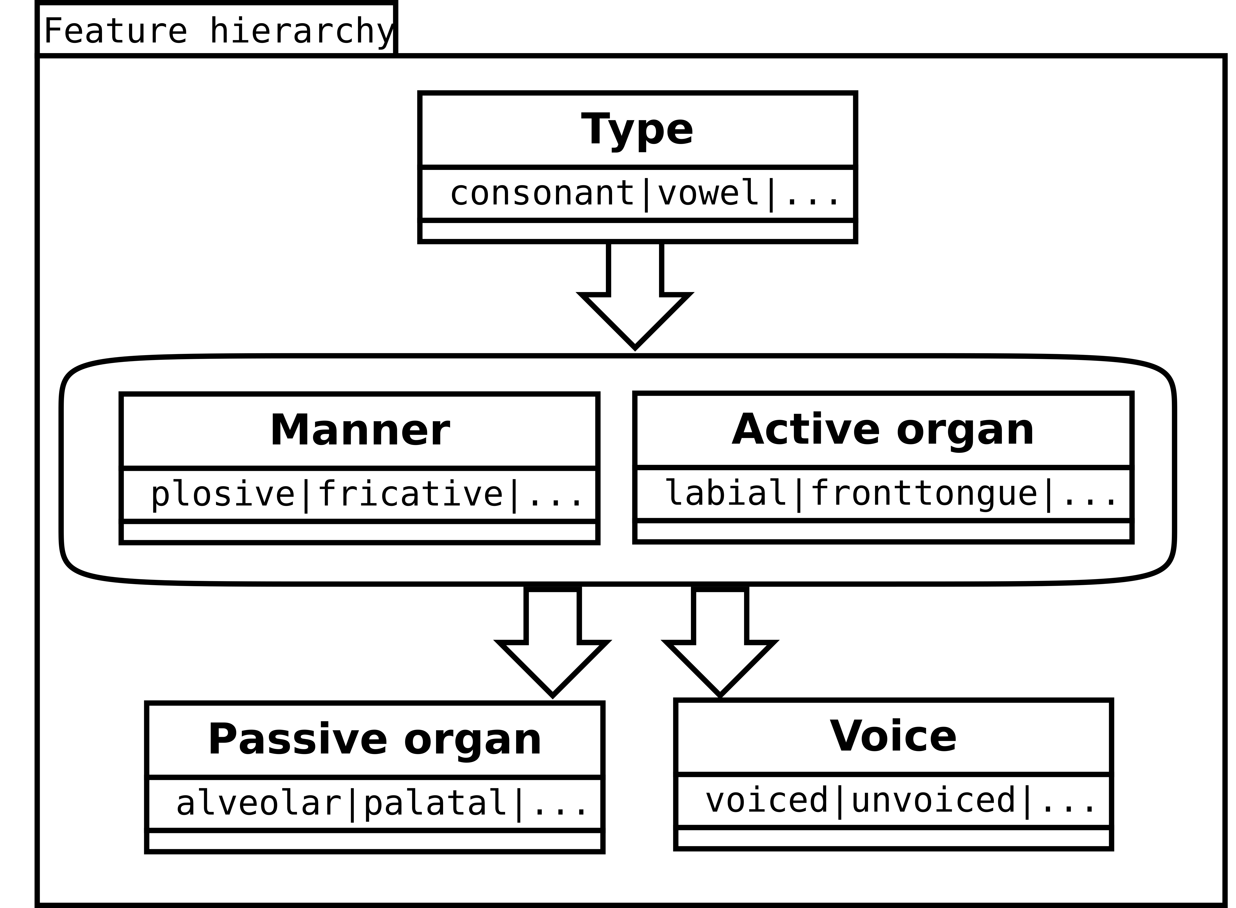

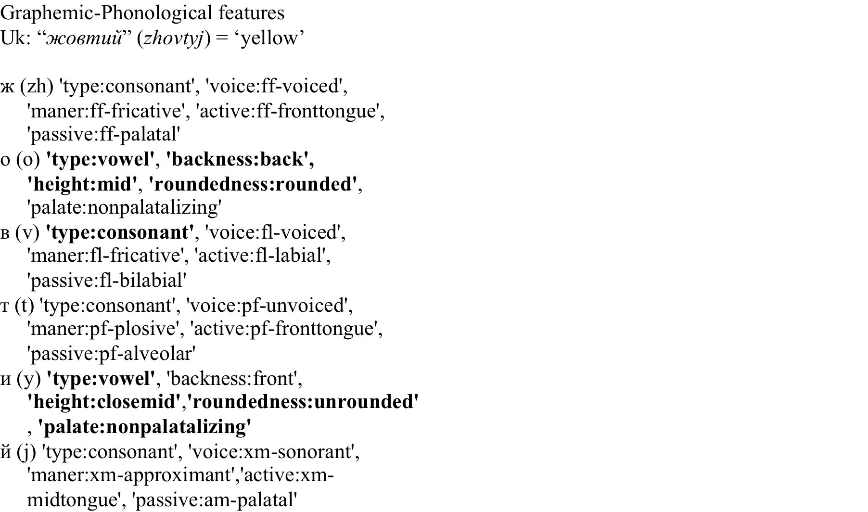

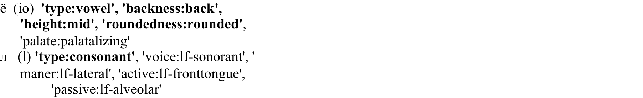
Development and evaluation of phonological models for cognate identification Bogdan Babych ( b.babych@leeds.ac.uk )
Using internal feature structures of characters
Current methods of cognate identification treat characters as atomic units (e.g., Levenshtein edit distance)
Engineering best-performing feature configuration for large-vocabulary cognate identification (rank candidates in >100k word space)
Optimal feature topology… ?
or
…
… optimal cost for insertion, deletion … ?

Slide 2
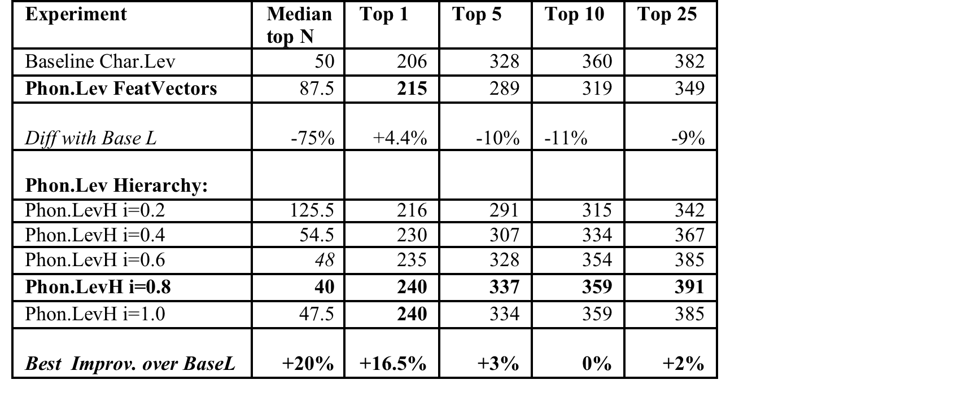
Automated evaluation framework for phonological feature engineering
Evaluation results
Best performance for the settings:
Feature hierarchy +
Insertion/deletion = 0.8
Improvement over baseline ‘atomic’ character Levenshtein distance
+20% median cognate rank
+16.5% cognate in top 1
+ 3% cognate in top 5

